Slide 1
Exploiting Perceptual Anchoring for Color Image Enhancement
第12組：黃湛元
黃煜堯
曾勁凱
教授：陳宏銘 教授

Slide 2
Outline
Exploiting Perceptual Anchoring for Color Image Enhancement
Gamma Correction – CIELUV & HSV & YCrCb & RGB
Model Analysis - CIELAB & HSV
HSV Enhancement
Color Correction
Color Correction + SLIC + CIECAM02
Low Light Enhancement

Slide 3
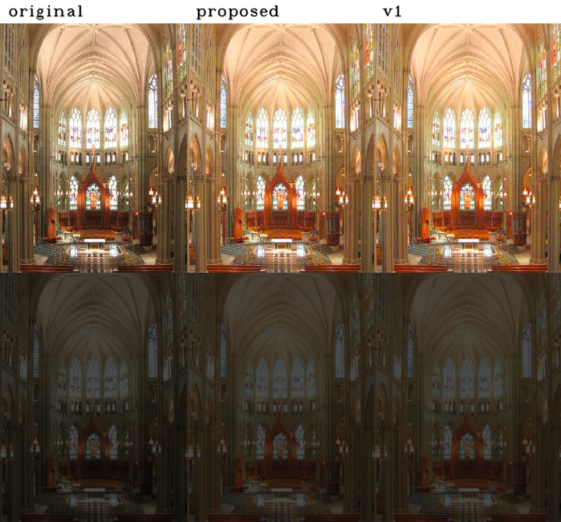
Exploiting Perceptual Anchoring for Color Image Enhancement

Slide 4
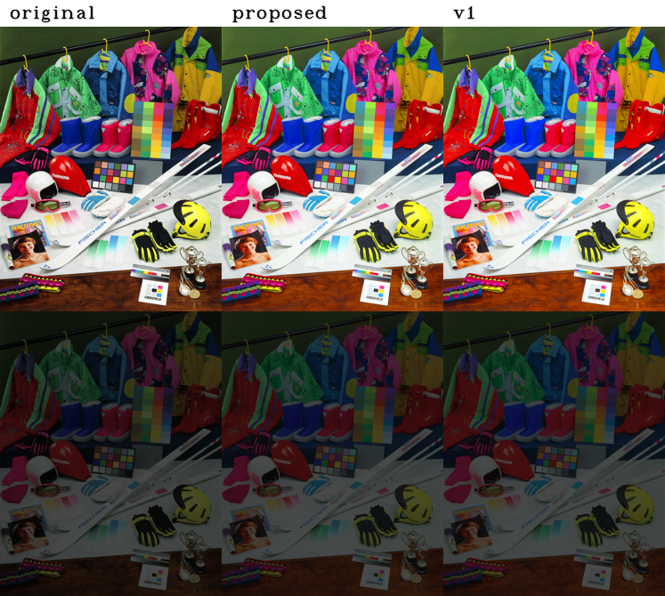
Exploiting Perceptual Anchoring for Color Image Enhancement

Slide 5
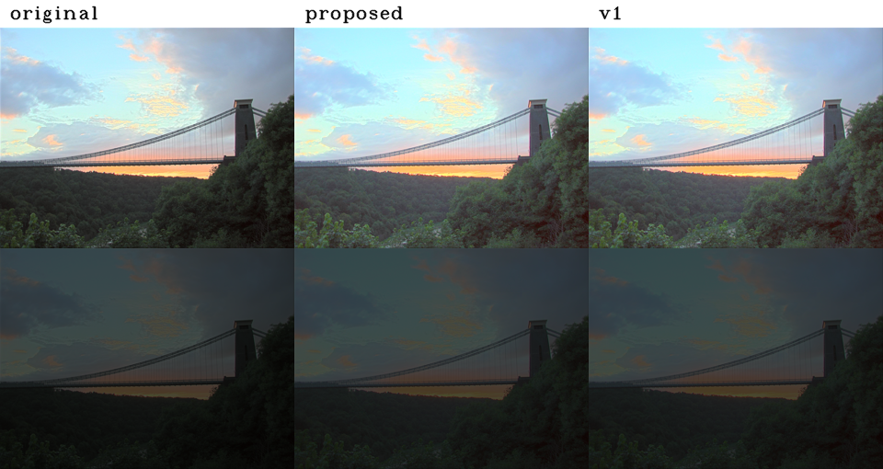
Exploiting Perceptual Anchoring for Color Image Enhancement

Slide 6
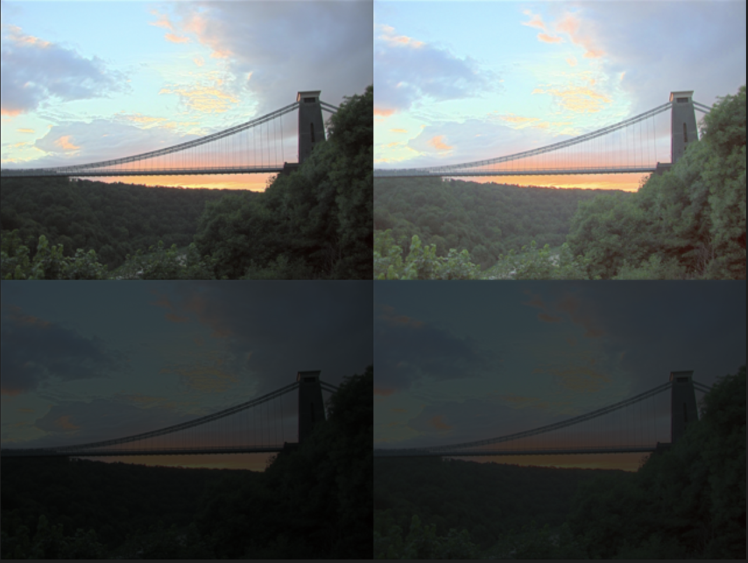
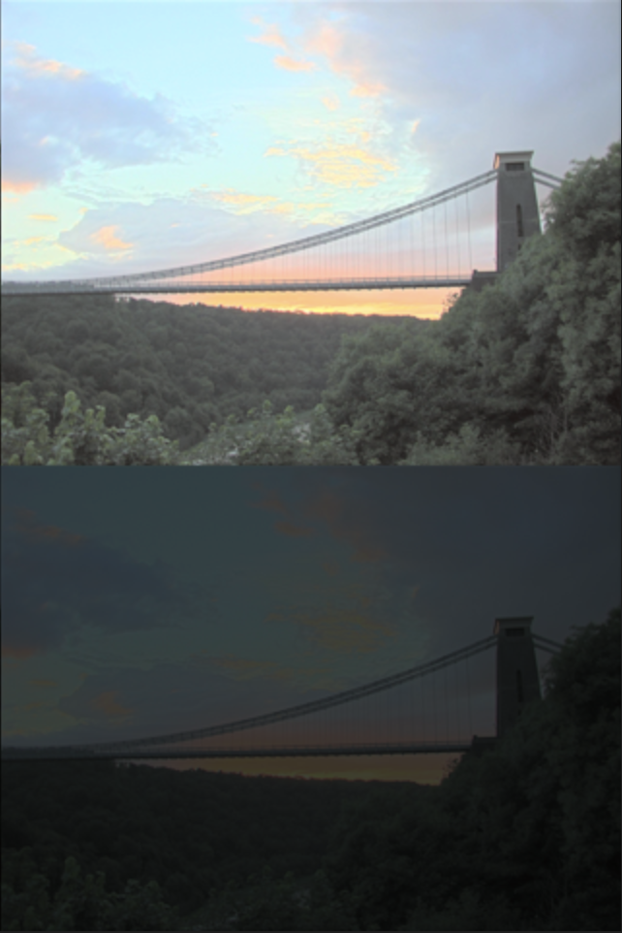
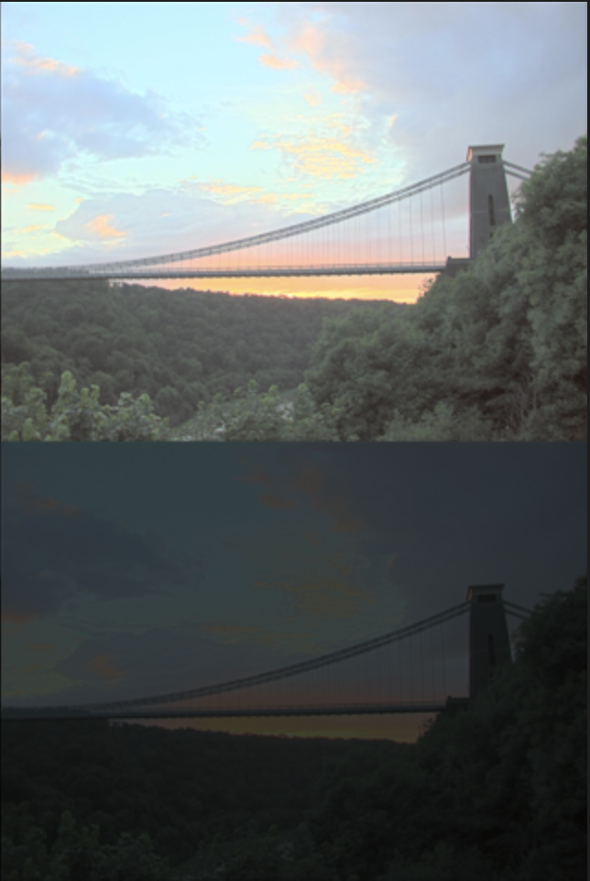

Gamma Correction
original
HSV
CIELUV
YCrCb
RGB

Slide 7
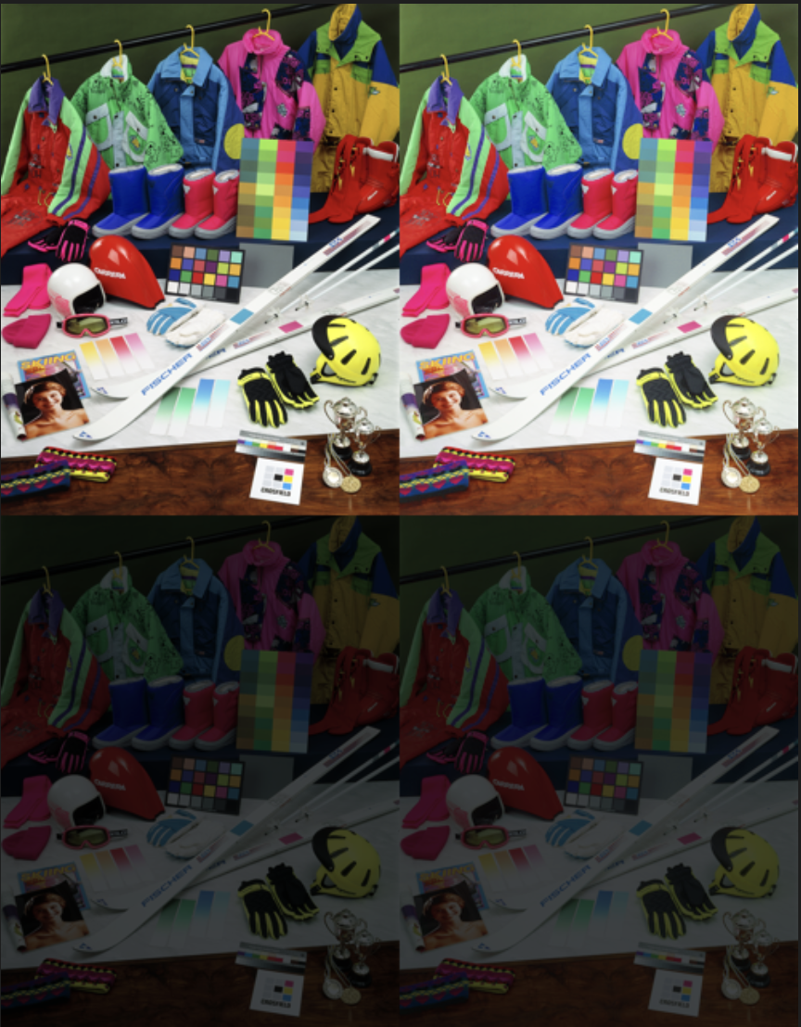



Gamma Correction
original
HSV
CIELUV
YCrCb
RGB

Slide 8
Model Analysis - CIELAB
L*a*b* model (L=1~100)
Fits within the gamut (r g b : 0~255)
難しすぎる…

Slide 9
Model Analysis - HSV
HSV model (V=1~100) (r g b : 0~255)

Slide 10
HSV Enhancement - Local Gamma Correction
S, V

Slide 11
HSV Enhancement - Linear Normalization
H

Slide 12
HSV Enhancement
Original
Enhance V
Enhance S
Enhance H

Slide 13
HSV Enhancement
Original
Enhance V
Enhance S
Enhance H

Slide 14
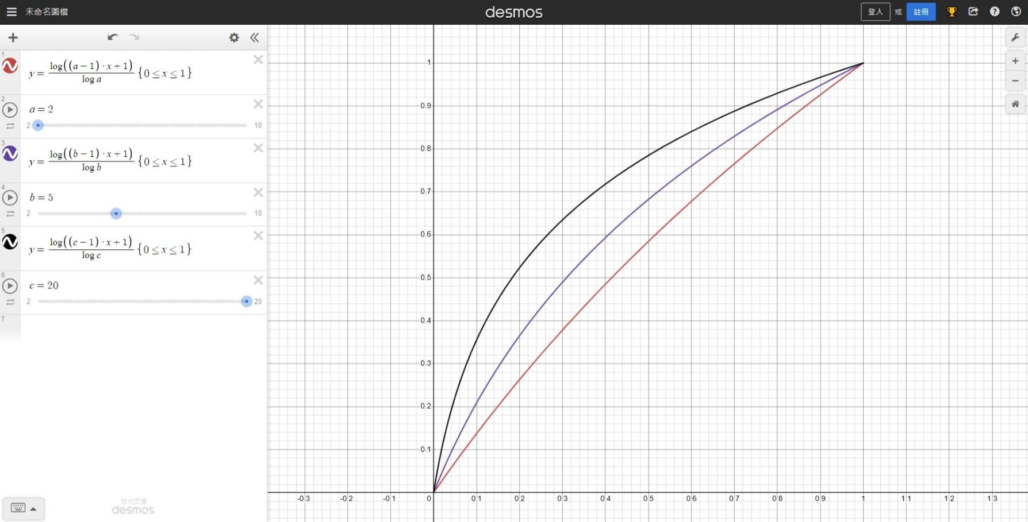
Color Correction

Slide 15
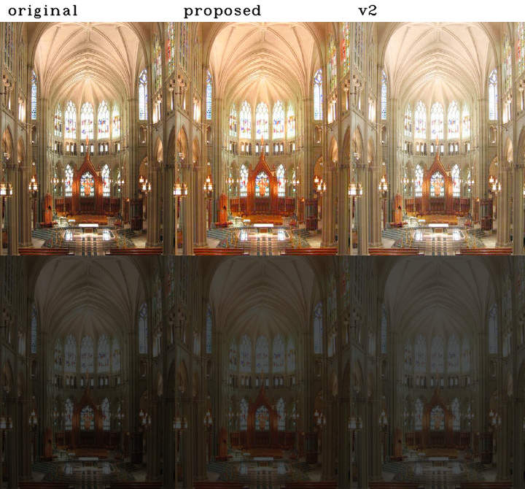
Color Correction

Slide 16
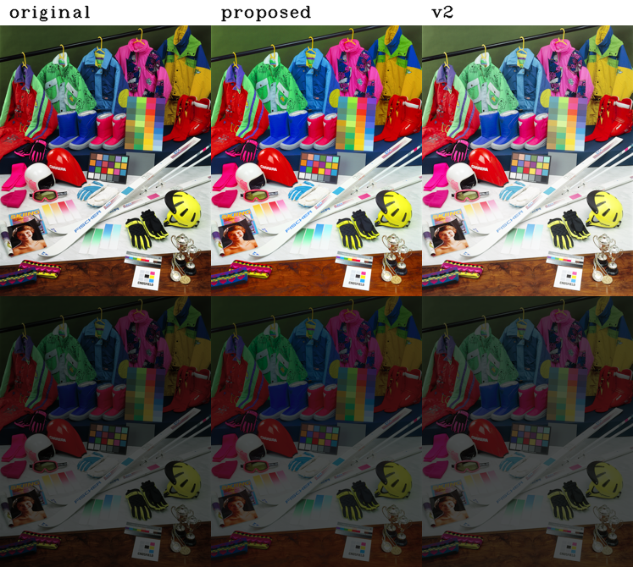
Color Correction

Slide 17
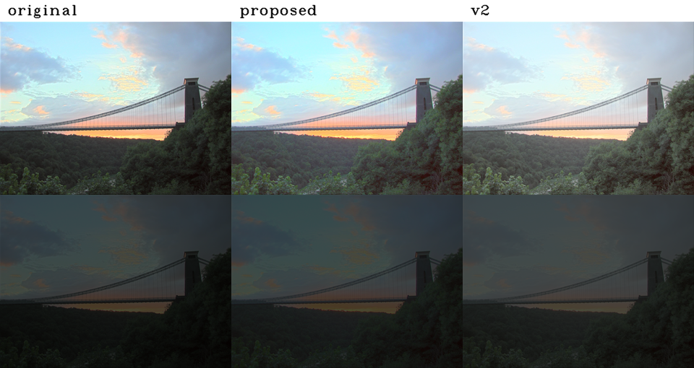
Color Correction

Slide 18
Color Correction+SLIC+CIECAM02
SLIC – super-pixel segmentation – mean color
Use CIECAM02 to get lightness J and chroma C
Set a = np.sqrt(1/(J*C))

Slide 19
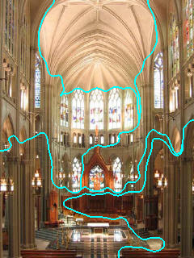

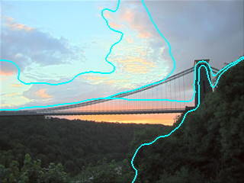
Color Correction+SLIC+CIECAM02

Slide 20
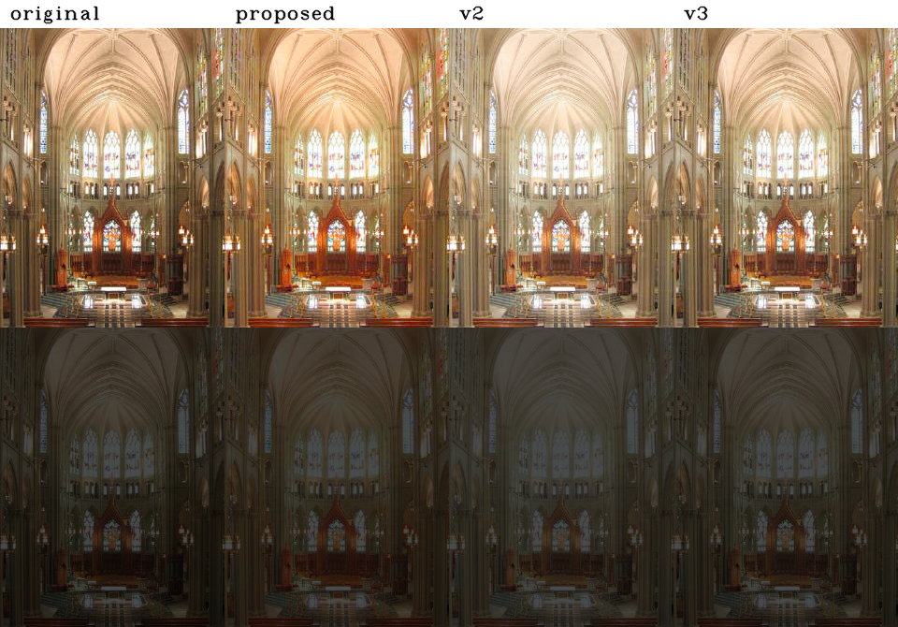
Color Correction+SLIC+CIECAM02

Slide 21
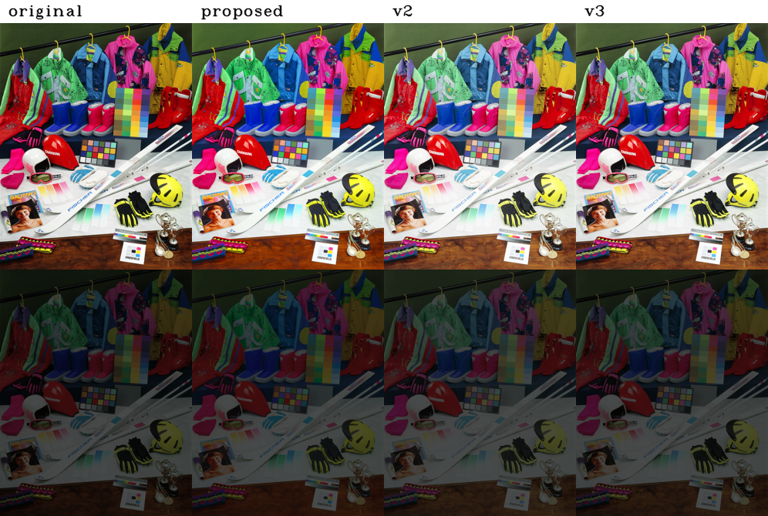
Color Correction+SLIC+CIECAM02

Slide 22
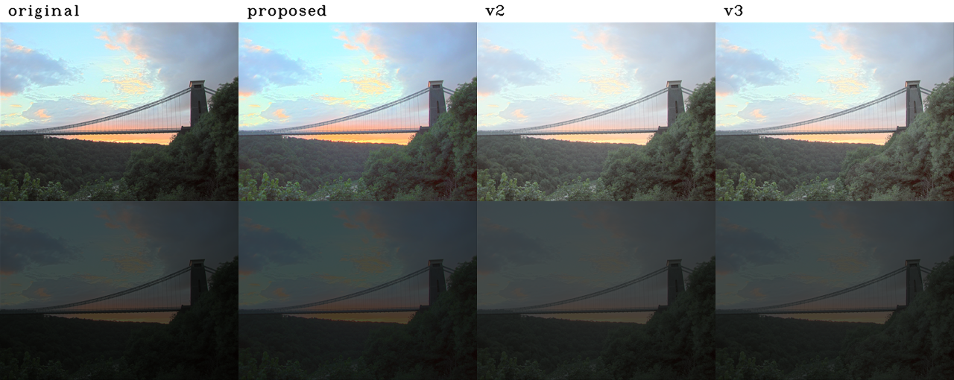
Color Correction+SLIC+CIECAM02

Slide 23
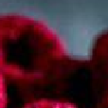
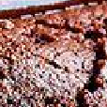
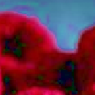
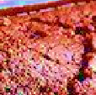
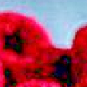
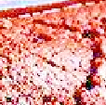
Low Light Enhancement
Original
Enhanced
Xuan Dong, 2011

Slide 24
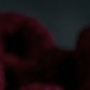
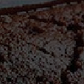
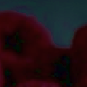
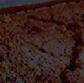
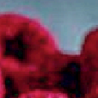
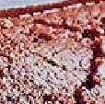
Low Light Enhancement
Original
Enhanced
Xuan Dong, 2011

Slide 25

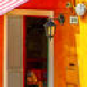

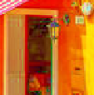

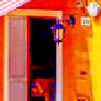
Low Light Enhancement
Original
Enhanced
Xuan Dong, 2011

Slide 26




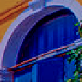
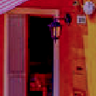
Low Light Enhancement
Original
Enhanced
Xuan Dong, 2011

Slide 27


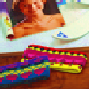



Low Light Enhancement
Original
Enhanced
Xuan Dong, 2011

Slide 28


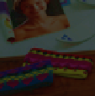

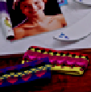
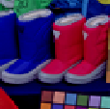
Low Light Enhancement
Original
Enhanced
Xuan Dong, 2011

Slide 29
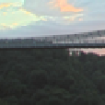

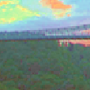

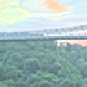

Low Light Enhancement
Original
Enhanced
Xuan Dong, 2011

Slide 30


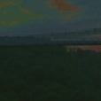

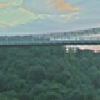

Low Light Enhancement
Original
Enhanced
Xuan Dong, 2011

